Slide 1

BATCH | PGPDSE-FT GURGAON AUG22
TEAM MEMBERS | Pawan Kumar Kushwaha Kundan Kumar Bittoo Kumar Lakshay Singh Karan Malik
Domain | Finance
Project Title | Fraud Detection
Mentor Name | Mrs. Trupti Mathapati

Slide 2
BUSINESS PROBLEM STATEMENT
Bank losses tons of amount due to credit card payment defaulter and this study will help them to know which segment of customers have high risk of default and how they can hedge their position by not issuing the cards.
Almost 15% of the credit card default leads to legal action for recovery and this have resulted in great extent of fee to be borne by the bank. To minimize this, it is important to get to know the source of default and the reasons behind such as income stability, job position, Locality, etc.
To tackle this problem, we are building the Machine Learning model to predict the upcoming fraud based on inputs.

Slide 3
DATA DESCRIPTION / TARGET VARIABLE
trans_date_trans_time | Transaction date and time of payment. | lat | Customer Latitude
cc_num | Credit Card Number | long | Customer Longitude
merchant | Company Name | city_pop | City population
category | Business Type | job | Designation
amt | Transaction Amount | dob | Date of Birth
first | First Name | trans_num | Transaction Number
last | Last Name | unix_time | Machine Time
gender | Male/Female | merch_lat | Merchant Latitude
street | Address | merch_long | Merchant Longitude
city | Location | is_fraud | Fraud Prediction (0 False and 1 True)
state | Location
zip | Zip / pin code

Slide 4
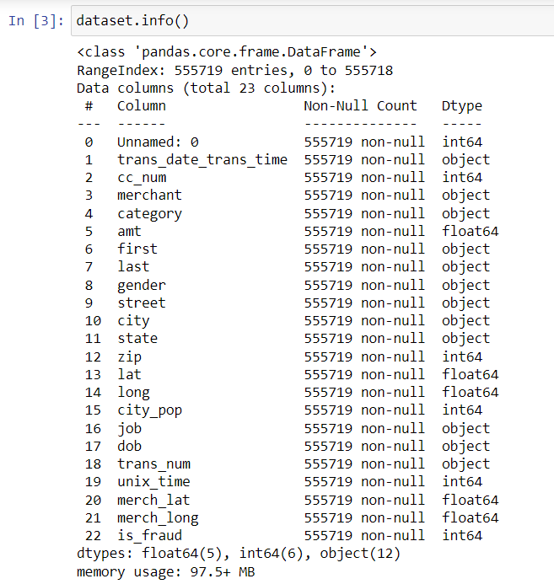
DATA INFORMATION
Rows: 5,55,719 and Columns: 23
From dob we have taken the birth in the consideration
We have no null values.
There was no duplicate rows.
We have taken the following columns as a part of study because other column was creating noise in the data. 'category', 'amt', 'gender', 'city', 'city_pop', 'dob', 'is_fraud'

Slide 5
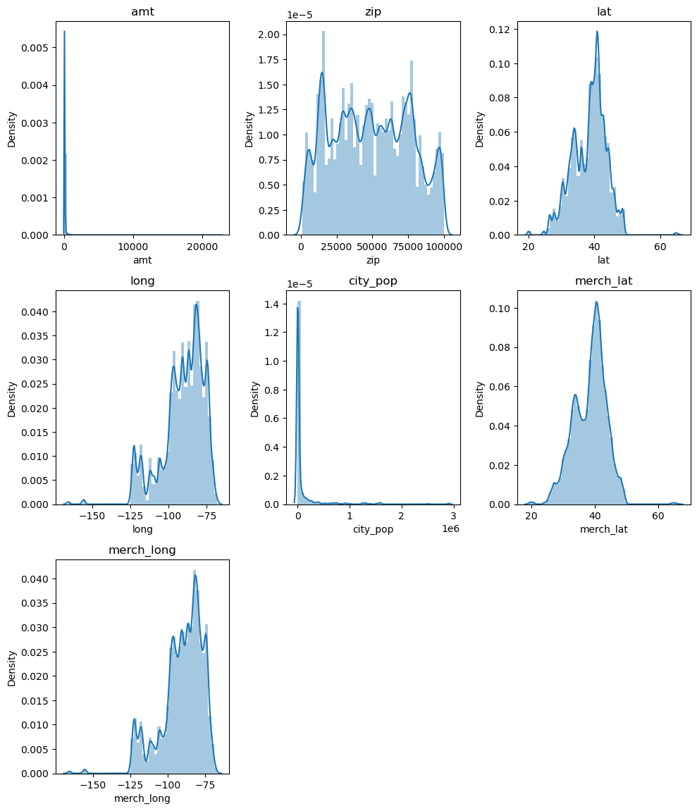
UNIVARIATE ANALYSIS FOR NUMERICAL COLUMNS
amt and city_pop column is skewed with some about normal distribution.
Zip, lat and long is showing uniform distribution.
Merchant lat and long also shays that there are some more merchant located to one area.

Slide 6
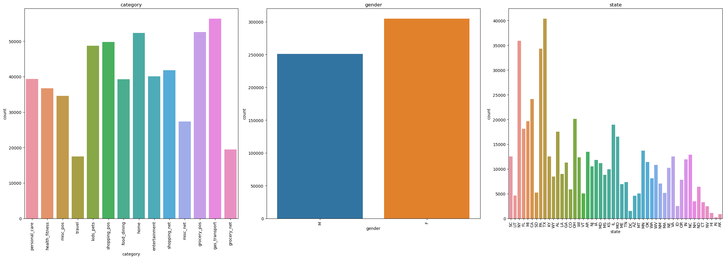
UNIVARIATE ANALYSIS FOR CATEGORICAL VARIABLES
category of the product is widely distributed. With the most transaction done on gas followed by grocery and dinning. With the minimum count on travel.
In our data there are more females than males.
State column shows us that most transaction is done on Texas(TX).

Slide 7
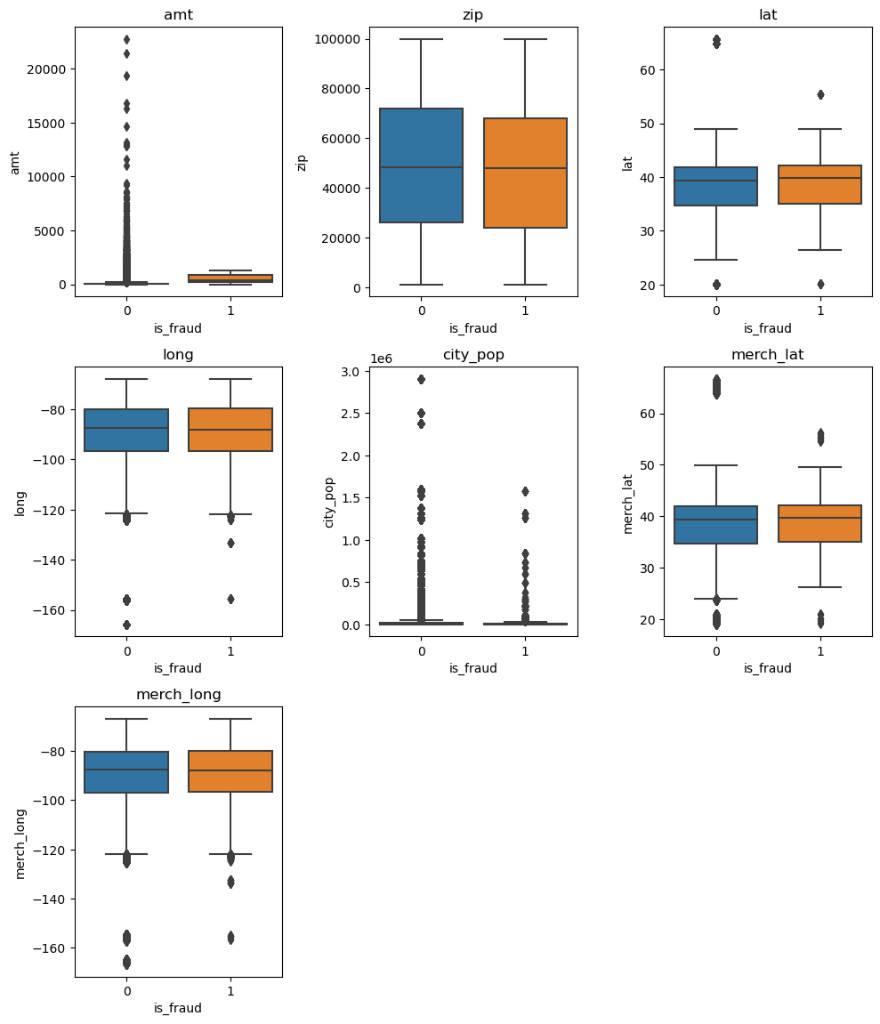
BIVARIATE ANALYSIS NUMERICAL VS CATEGORICAL
Through the boxplot we can say that there are outliers in the data.
Amt column have huge IQR range.
Longitude and Latitude columns of customer and merchant shows fraud transaction are distributed widely same as non-fraud transaction.

Slide 8
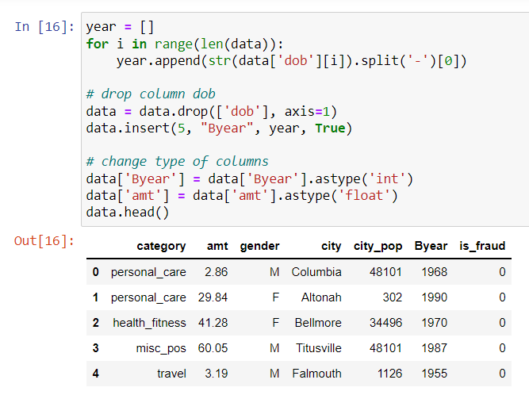
FEATURE ENGINEERING
We have taken the birth year from dob column into the model.
We have dropped the columns : - unnamed, trans_date_trans_time, cc_num, merchant, first, last,street, lat, long, city_pop,trans_num, unix_time, merchant_lat, merchant_long.
Moreover, we changed the data types of the Byear and amt column

Slide 9
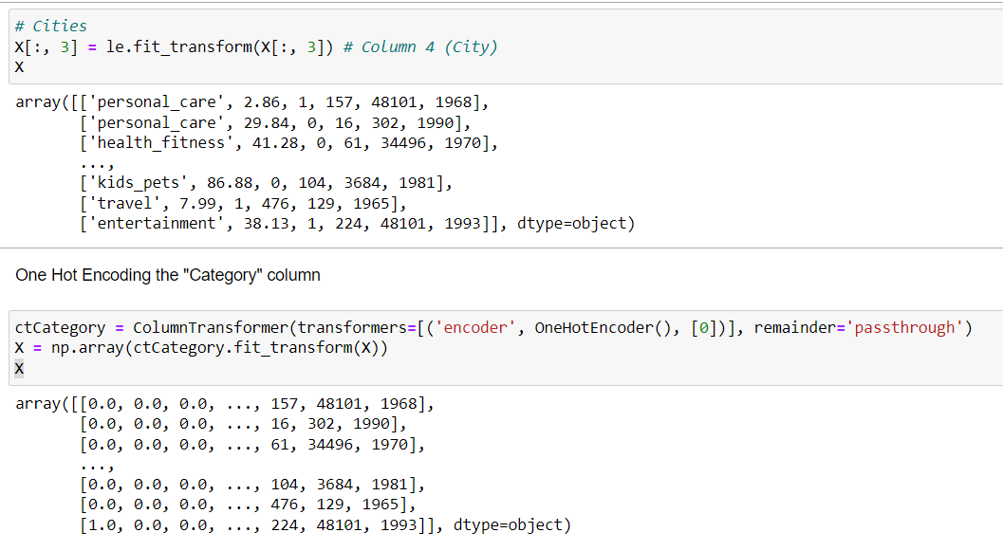
ENCODING
Here, for gender column we did label encoding (Male 1 and Female 0).
For the city also we have done the LabelEncoder.
And finally for the category column we have done the One Hot Encoding.

Slide 10
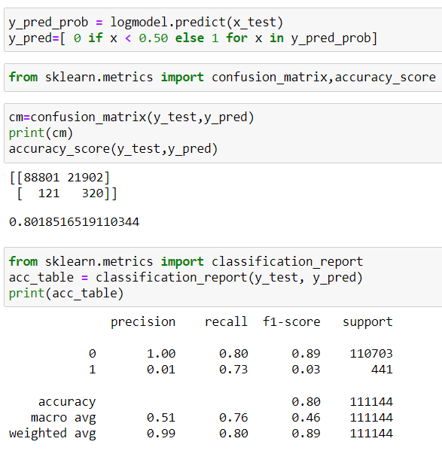
MACHINE LEARNING MODEL
Logistic Regression: In first we have created the base model after balancing the data.
Accuracy Score: 0.80
SMOTE has been used to balanced the data. So, model cannot get overfitted.

Slide 11
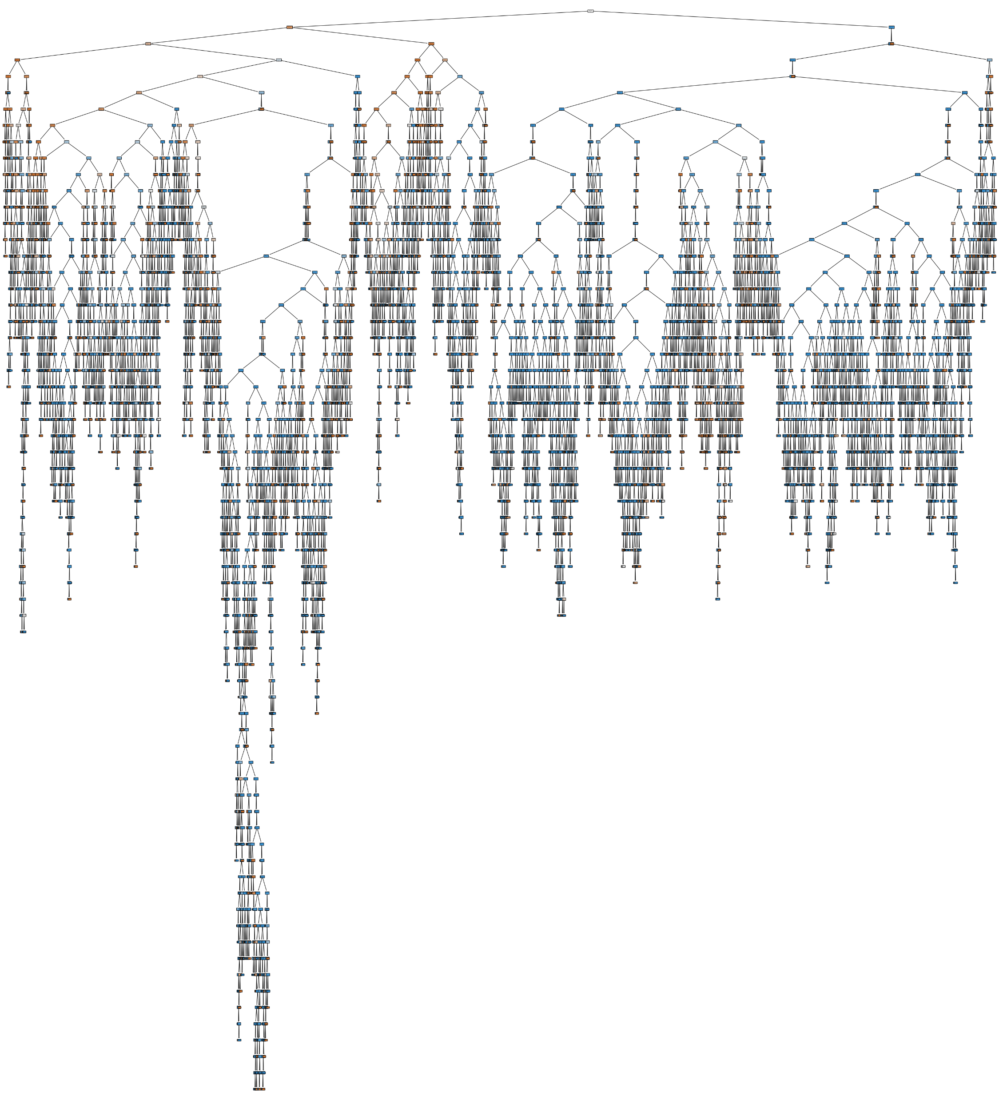
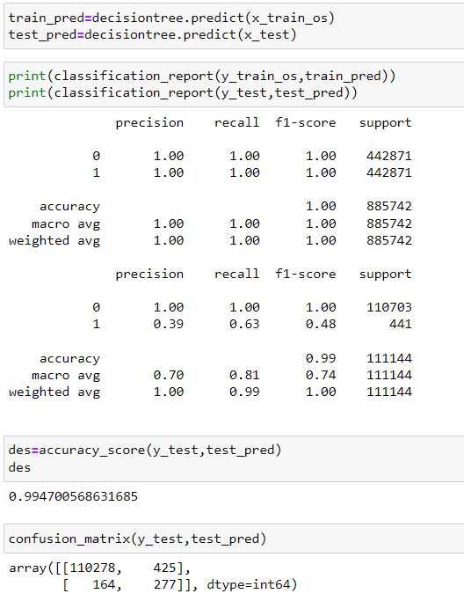
MACHINE LEARNING MODEL
Decision Tree: Than we moved to the decision tree model.
Accuracy Score: 0.995
Based on confusion matrix, we can say that there is difference in the train and test accuracy, therefore it is over-fitted model.
To reduce the over-fitting, we can use hyperparameter GridSearchCV.

Slide 12
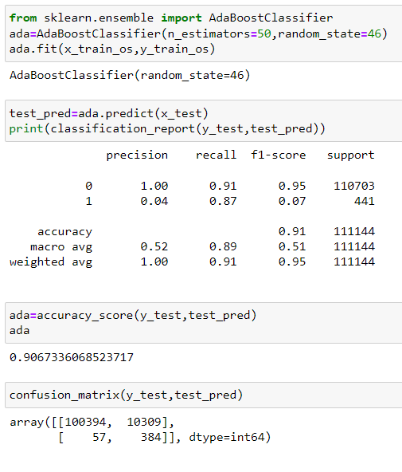
MACHINE LEARNING MODEL
Ada Boost
Accuracy Score: 0.907
Through this model we can say that this model is far better than the overfit model.
Through weighted avg we can say that balancing have the great effect on Ada Boost model.

Slide 13
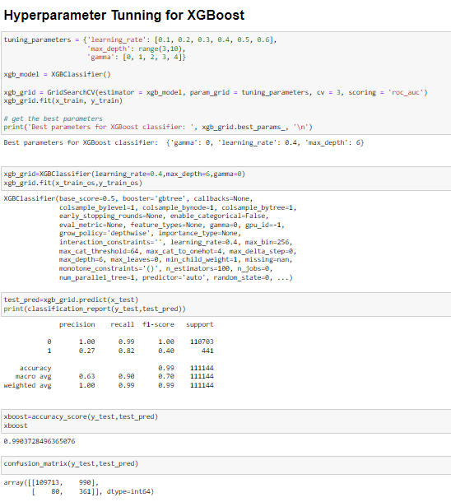
MACHINE LEARNING MODEL
Using Gradient Boosting and XGradient Boosting methods we got the over-fitted model.
To reduce we tried Hyper-parameter Tunning for XGB and we still got the over fitted model.
Gradient Boosting Accuracy Score: 0.992
XGradient Boosting Accuracy Score: 0.995
Hyperparameter XGB Accuract Score: 0.990

Slide 14
CONCLUSION
Dataset was huge and time taking, the challenge we faced in on the encoding part and the variable consideration. And we dropped more than half columns to get the best out of machine learning model.
There was less than 1% of fraud done in the whole dataset. To deal with the imbalance data we used the Over Sampling.
Ada Boost was more accurate and precise model for us here.

Slide 15

THANK YOU!

